Slide 1
Gym Location in Barcelona
IBM Data Science Professional Certificate – Capstone Project

Slide 2
Importance of location of a new gym/fitness center
Barcelona is a very popular city with an intrinsic interest for investors in the fitness industry. The city has an intense relationship with sports & fitness.
Analysis based on 3 “common-sense” assumptions:
1. Neighbourhoods with a high density of these types of venues are NOT recommended, due to the very high competition that is already there.
2. Neighbourhoods that are well-connected, that contain many public transport stops, bike rental stations, etc. are more interesting.
3. Neighbourhoods that contain many different services, that can provide many different solutions to the gym client as they get to/come out of the gym, are more interesting.

Slide 3
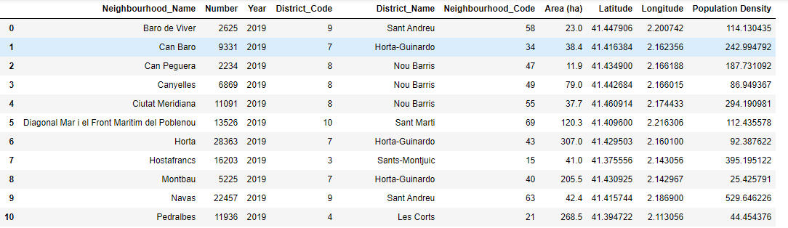
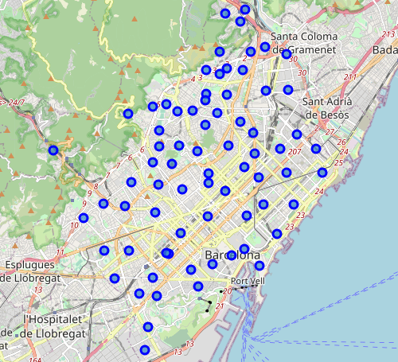
Working Dataset

Slide 4
Exploration of different types of venues in all neighbourhoods of BCN

Slide 5
3D K-Means Clustering

Slide 6
Results & Conclusions

Slide 7
Thank you very much!

